Slide 1

ICC Arbitration Presented bY Shanil Fernando
Attorney at Law, MBA, MSiArb

Slide 2
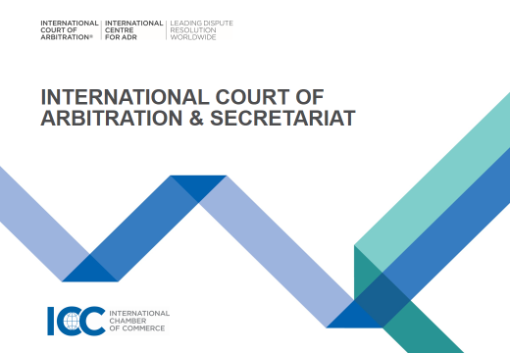

Slide 3
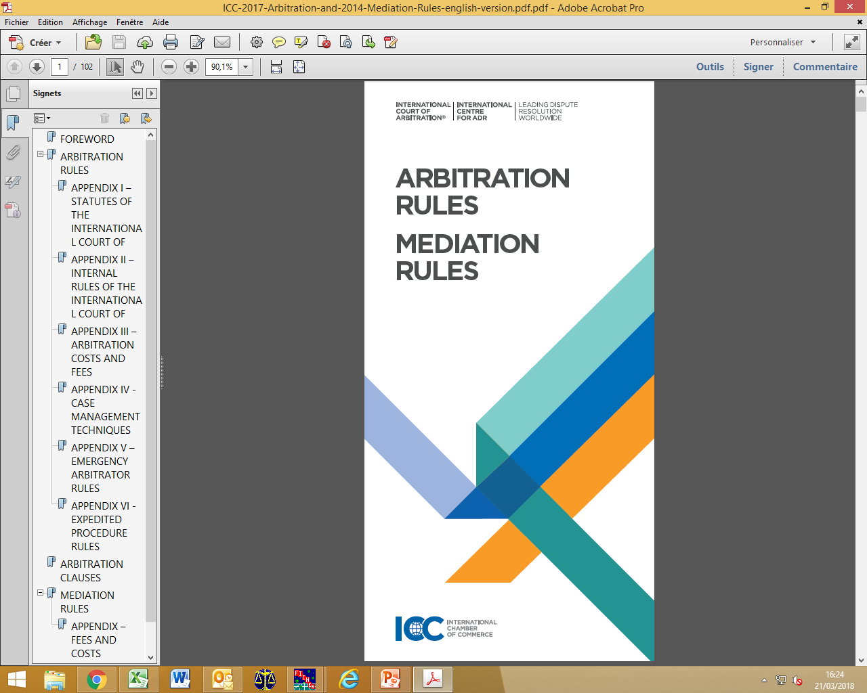
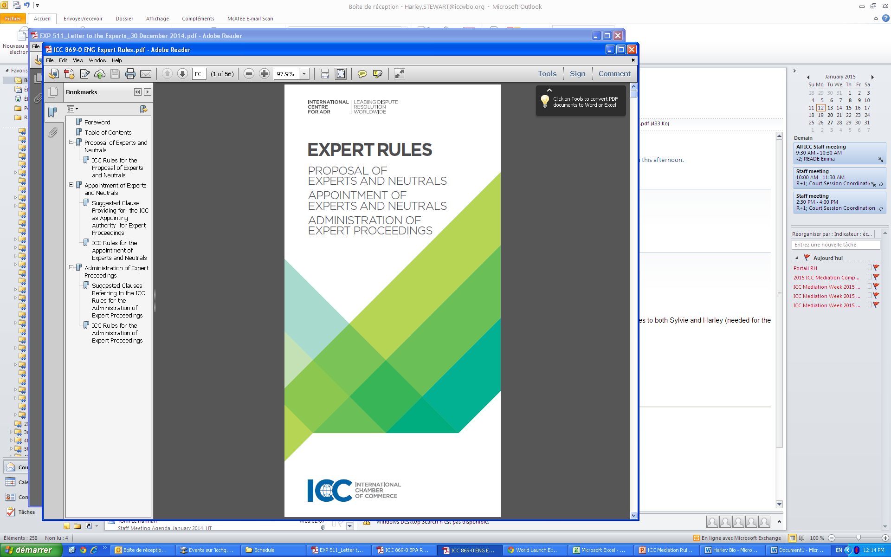


ICC dispute resolution services
ICC International Court of Arbitration
ICC International Centre for ADR

Slide 4
WORLD CLASS ADMINISTRATION & EXPERIENCE
ICC International Court of Arbitration
1 President 17 Vice-Presidents 120+ members worldwide
ICC Court Secretariat
11 Case management teams
ICC International Centre for ADR
ICC Commission on Arbitration and ADR
Weekly committee sessions
Monthly plenary sessions
50+ Lawyers
30+ Nationalities
30+ Languages
1 Case management team = 5 lawyers
Standing committee = 6 members
Responsible for drafting dispute resolution rules
700+ members worldwide
“Legislative body”

Slide 5
The international court of arbitration
International Court of Arbitration (HQ in Paris) | Arbitral Tribunal (any place in the world)
Does not settle itself disputes Supervises the work of the Arbitral Tribunals and administers the proceedings Constitution of the Arbitral Tribunal Control of time limits under the Rules Award scrutiny Fixes arbitrator’s fees and administrative expenses | Decision on the merits of the case Management of the case in consultation with the parties Principles of rapid, diligent and contradictory process Draft the terms of reference, renders procedural orders and awards Decides on the allocation of costs among the parties
ICC INTERNATIONAL COURT OF ARBITRATION ICC INTERNATIONAL CENTRE FOR ADR

Slide 6
The international court of arbitration
The Court sessions are in French and English but can sometimes be in Spanish or German
Members of the Court are appointed for a renewable three-year term by the World Council of the ICC
Composition
One President: Alexis Mourre
Sessions
145 Members from 84 countries and territories
Committee sessions
Weekly
3 Court members
All type of decisions
Plenary sessions
Monthly
Open to all Court members
Challenges, majority awards, States
To date: 24 000+ cases
Founded in 1923
17 Vice-Presidents
ICC INTERNATIONAL COURT OF ARBITRATION ICC INTERNATIONAL CENTRE FOR ADR

Slide 7














THE ICC SECRETARIAT
Secretary General Deputy Secretary General Managing Counsel
France/
Africa
Singapore
LatAm
Commonwealth
NorthAm
(in NY)
Swiss/ Italy
Eastern Europe
Eastern
Mediterranean
German
Hong Kong
Brazil
(in São Paulo)
Composition
Approx. 80 staff members
German
Int’l Centre for ADR
& Expertise
Diverse nationalities & languages
Commission on Arbitration
& ADR
One counsel, several deputy counsel per team
Trainings & conferences
Mission
Daily case administration
Contact with parties, arbitrators
Advice on practices, briefings and recommendations to the Court
Documentation
& research centre
Publications
Communication with parties and Arbitral Tribunals
General info on application of the Rules
ICC INTERNATIONAL COURT OF ARBITRATION ® ICC INTERNATIONAL CENTRE FOR ADR

Slide 8
Standard ICC ARBITRATION CLAUSE
“All disputes arising out of or in connection with the present contract shall be finally settled under the Rules of Arbitration of the International Chamber of Commerce by one or more arbitrators appointed in accordance with the said Rules”.
Emergency Arbitrators and Expedited Procedure Provisions apply according to conditions provided by the Rules.
Suggestions:
Place of arbitration
Language of arbitration
Applicable law
Number of arbitrators (1 or 3)
Notes:
Above standard clause which clearly identifies ICC as forum. Can be rendered more specific, often times parties opt for general clause for flexibility. Not always predictable what type of dispute.
Parties sometimes tend to be overly “creative”: problem. Danger of being overly specific. Pathological clause, f.ex.) identifies the arbitrator as an individual.
That’s when the fun starts for us: Court decision on (i) number of arbitrators and (ii) place of arbitration. However, (iii) language and (iv) applicable law: arbitral tribunal.
As a floater, I can say: varies significantly from one region to the other.
Opt out emergency arb & expedited

Slide 9
history
Notes:
Mientras en 1960 fueron registrados 60 casos, en 1980, veinte anos despues ya eran registrados 152, en el 2000 541 y en ano pasado la Corte registro 791 nuevos casos

Slide 10

REGISTERED CASES PER YEAR
2018
second best year in newly-registered arbitration cases in DRS history
Notes:
Mientras en 1960 fueron registrados 60 casos, en 1980, veinte anos despues ya eran registrados 152, en el 2000 541 y en ano pasado la Corte registro 791 nuevos casos

Slide 11
YEARLY breakdown OF ICC ARBITRATIONS by regional origin of parties

Slide 12
GENERAL STATISTICS (2018)
24 000+
842
1603
599
1484
Cases administered
New cases filed
Pending cases
Awards issued
Arbitrators confirmed or appointed

Slide 13
GENERAL STATISTICS (2018)
14,8%
Cases involving States or State entities
108
Cities as place of arbitration (in 60 countries)
2282
24
Emergency Arbitrator Applications (98 up to date)
Parties coming from 135 countries

Slide 14
TREND IN Number of Cases REGISTERED by year
Number of new cases filed in 2018
842
Including 24 applications for Emergency Measures
1 603 pending cases
14,8% of cases involving states or state entities

Slide 15
BREAKDOWN OF 2018 ICC ARBITRATIONS BY ECONOMIC SECTOR

Slide 16
main sectors - trends

Slide 17
AmountS in dispute in pending cases as of january 2019
Average amount in pending cases: US$ 131 546 145
Amount in dispute < US$ 2 million in 21% of cases
Notes:
Costs scale, unquantified, claim for declaration at discretion of court. Cost calculator average fee.

Slide 18
Places of Arbitration in 2018 icc arbitrations
Place of arbitration fixed by the Court in 8,1% of cases
Ranking for 10 first countries
Place of arbitration in 2008
50 countries
Place of arbitration in 2018
60 countries
108 cities
93 cities

Slide 19
Origins of parties IN ICC ARBITRATIONS
Number of parties in 2008
1758 parties
Number of
parties in 2018
2282 parties
135 countries
120 countries
32,7% of cases with more than two parties
25% of cases with parties of same nationality

Slide 20
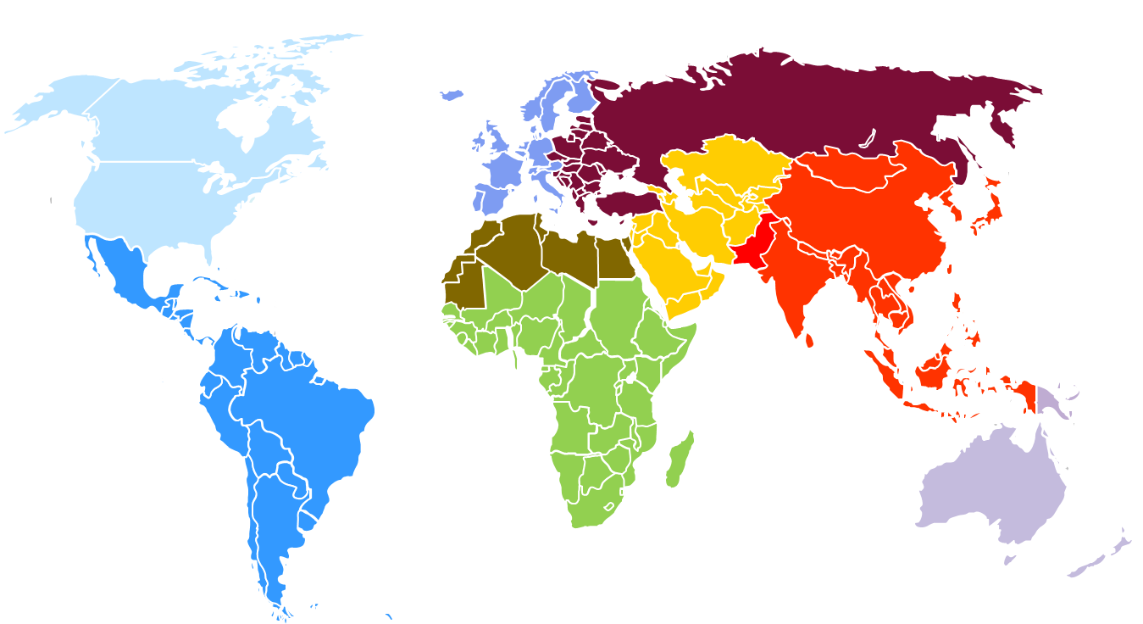

parties
31.6%
9.2%
10.8%
12.1%
12.1% –
2.6%
5.3%
14.9%
0.8% –
2018
2,282 parties
135 countries
33% (or 275) of new cases are multiparty
25% of cases involve parties of same nationality
15% of cases involve States or SoEs
Notable increase in parties from the Middle East and Central Asia
In all other regions, changes – if any – have been less significant

Slide 21
origins of parties: TOP 10 GENERAL RANKING
2016
1 | USA | 554
2 | US Virgin Islands | 269
3 | Belize | 135
4 | France | 124
5 | Brazil | 123
6 | Germany | 115
7 | Mexico | 105
8 | Spain | 88
9 | Italy | 84
10 | Rep. of Korea | 82
2017
1 | USA | 194
2 | Germany | 128
3 | France | 124
4 | Brazil | 115
5 | Spain | 102
6 | Italy | 73
7 | China PR (HK) | 69
8 | UK | 68
9 | Rep. of Korea | 59
10 | Netherlands | 57
2018
1 | USA | 210
2 | France | 139
3 | Brazil | 117
4 | Spain | 110
5 | Germany | 95
6 | Italy | 87
7 | Mexico | 71
8 | UAE | 69
9 | United Kingdom | 69
10 | Turkey | 62

Slide 22


origins of parties: TOP RANKINGs
2017
1 | USA | 8.3% | 194
2 | Germany | 5.5% | 128
3 | France | 5.4% | 124
4 | Brazil | 5% | 115
5 | Spain | 4.4% | 102
6 | Italy | 3.2% | 73
7 | China PR (HK) | 3% | 69
8 | UK | 3% | 68
9 | Rep. of Korea | 2.6% | 59
10 | Netherlands | 2.5% | 57
2018
1 | USA | 9.2% | 210
2 | France | 6% | 139
3 | Brazil | 5.1% | 117
4 | Spain | 4.8% | 110
5 | Germany | 4.1% | 95
6 | Italy | 3.8% | 87
7 | Mexico | 3.1% | 71
8 | UAE | 3% | 69
8 | UK | 3% | 69
10 | Turkey | 2.7% | 62
new
new
new
China PR (/HK SAR), Korea, the Netherlands, Saudi Arabia and India complete the 2018 top 15 ranking with numbers in the 50s.

Slide 23
ORIGINS OF Arbitrators IN ICC ARBITRATIONS
2008
1156 arbitrators
74 countries
2018
1484 arbitrators
87 countries
Notes:
More than 90 NC, list on website

Slide 24

arbitrators
52.6%
6.2%
11.2%
5.1%
5.9%
1.7%
1.4%
13.3% –
2.6% –
2018
1,484 appointments and confirmations –
1,021 individuals
87 countries
Increase in arbitrators from North America and Asia
Minor drops in other regions save LatAm

Slide 25
Constitution of tribunals
57.5%
17.6%
10%
0
Nominations by parties
Nominations by co-arbitrators (for presidents)
Appointments by Court directly
Appointments by an authority other than the Court
Appointments by Court upon proposal from ICC National Committee or Group
14.9%
2018
Very slight drop in party nominations
As more arbitrators served in 2018, Court appointed slightly more arbitrators than in 2017

Slide 26
General statistics: awards
Number of Awards Approved in 2018
599

Slide 27
2018 AWARDS
599 awards approved
99,6% of the approved awards were approved with comments (“subject to modification”)
63 awards sent back (10,5% of awards)

Slide 28
SCRUTINY OF AWARDS: TREND 2008-2018
2008:
407 Awards
25 not approved
363 approved “subject to”
44 approved without comments
2018:
599 Awards
63 not approved
595 approved “subject to”
4 approved without comments
Total awards approved
Awards approved "subject to" Awards approved without comments
Awards sent back
ICC INTERNATIONAL COURT OF ARBITRATION ® ICC INTERNATIONAL CENTRE FOR ADR

Slide 29
MAJORITY AWARDS: TREND 2008-2018

Slide 30
Ica ADMINISTERS ARBITRATIONS UNDER THE RULES
Prima facie jurisdiction over parties and/or claims (art. 6(4) i) ii))
Consolidation of cases (art. 10)
Place of arbitration (art. 18)
Number of arbitrators/ confirmation/ challenge/ replacement (art. 12-15)
Advances on costs/ separate aoc/ arbitrators’ fees (art. 37 & Appendix III)
Scrutiny of award (art. 34)
Approval TOR if lack of signature or lack of participation of one party (art. 23(3))
Notes:
Confirmation and challenge, issue of impartiality independence, availability. Sometimes qualifications or knowledge in specific area (specified in arb. clause or unilateral requirement). Challenges can be based on independence or “otherwise” (breach of due process, alleged misconduct and partial behaviour…). Request for replacements: (joint) or a request by a party can triger the Court to initiate replacement proceedings (stats..)
Guide: 2001-2011: 7% of challenged accepted
Replacement, same procedure for appointment. Truncated tribunal 15(5).

Slide 31
Scrutiny of award (art. 34): PROCEDURE
Before signing any award, the arbitral tribunal shall submit it in draft form to the Court.
The Court may lay down modifications as to the form of the award and, without affecting the arbitral tribunal’s liberty of decision, may also draw its attention to points of substance.
No award shall be rendered by the arbitral tribunal until it has been approved by the Court as to its form.
Art. 32(2): The award shall state the reasons upon which it is based
App. II, Art. 6: When the Court scrutinizes draft awards, it considers, to the extent practicable, the requirements of mandatory law at the place of the arbitration.
Art. 42: In all matters not expressly provided for the Rules, the Court and the AT shall act in the spirit of the rules and make sure that award is enforceable at law.
Notes:
All issues have been dealt with
Enforceability / Public Policy
Due process
Consistency/Sufficiency of reasoning
Calculations
Allocation of arbitral and legal Costs
time limit (Article 30)
Art. 41. general rule: the Court shall act in the spirit of the rules to ake sure the award is enforceable at law.
Particularly relevant in cases involving less experienced arbitrators, but also experience arbs.
Improves the quality of the award
Enhances enforceability
Évite l’application trop fréquente de l’art. 35. (correction de forme)
Eventually correction and interpretation of the award: Article 35

Slide 32

More information on www.iccarbitration.org
Events & Online Learning, Young Arbitrators Forum (YAF), carriers & internships …
ICC Digital Library http://library.iccwbo.org/ : Material available upon subscription & free access
Notes:
DRL
Free access to enforcement guide, secretariat’s note and commission report

